Slide 1
Prometheus Monitoring and Alerting for Everyone
Notes:
What do we do? We bring intelligence to your marketing
Making your unknown known
We bring intelligence to retargeting to
We bring intelligence to your site traffic
Multi medium
Take retargeting offline
Webpowered direct mail
Everyone needs new customers.
Only 2% convert.
Focus is on the 98% - mining the site visitors. Much more efficient than going out and finding brand new.
Why fish in the ocean when you can fish in your own pond.
We are bringing sexy back
Dick in a box
Direct mail is the vehicle
We maximize your site traffic
Should be channel agnostic

Slide 2
Introductions

Slide 3



Infrastructure Engineer @ NaviStone
LinkedIn: kherner
Twitter: @kenXengineering
VP of Engineering @ NaviStone
LinkedIn: abrongersma
Twitter: @abrongersma
Notes:
Ken bio
Aaron bio:
5+ years running containers in production.
Passion for Infrastructure, containers and cloud.

Slide 4

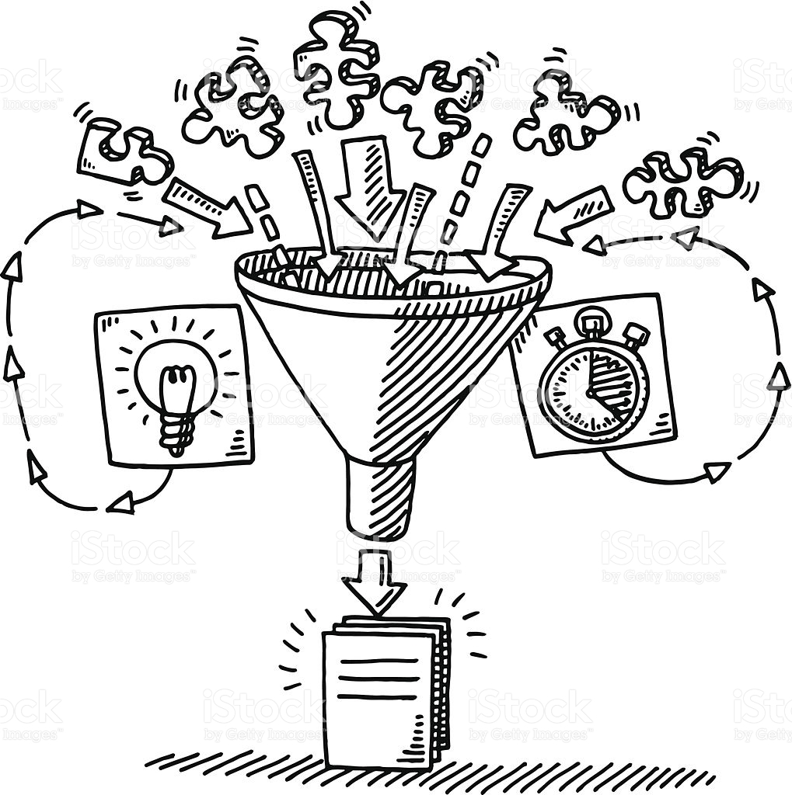

What we do at NaviStone
1
2
3
Collect & Model
Match
Mail
Collect browsing data and use statistical modeling, analytics & scoring to determine propensity to convert.
Connect the unknown site browsers to postal name/address.
Audiences delivered for turnkey postcard, in home within 48 hours or campaign mailings
4

Slide 5
Postcards

Slide 6
Some stats
Ingestion API
Over 1500 - events ingested per second
Over 90mil - events ingested per day
API written entirely in .Net
Postcards
100k - postcards mailed each week
48 hours - time first site visit until a postcard is in the mail
2 – trips to the post office each week to clean out our P.O. Box

Slide 7
What is Prometheus?
Data collection
Prometheus in Production
Prometheus & Kubernetes
Closing remarks and questions

Slide 8
What is Prometheus?
Notes:
Collecting Aggregated data. Isn’t an event-base monitoring system, like StatsD. Prometheus is meant to collect the current state of a given set of metrics.
Prometheus teams focus on whats most important: providing a highly performant and reliable way to for collecting metrics.
No fancy interface -> Grafana
No HTTPS for web interface -> Use nginx, caddy, HAProxy
No auth -> Use LDAP, Oauth and proxy
Can create alerts with connected with alertmanager. Alert rules are defined in Prometheus, while alertmanager sends alert to external systems

Slide 9
What is Prometheus?
Monitoring system and time series database
Collects aggregated time series data
Highly performant and reliable at collecting metrics
no fancy interface
no HTTPS for web interface
no authentication/authorization
Written in Go
Raises alerts when paired with alertmanager
Can send alerts to 3rd party services
Notes:
Collecting Aggregated data. Isn’t an event-base monitoring system, like StatsD. Prometheus is meant to collect the current state of a given set of metrics.
Prometheus teams focus on what's most important: providing a highly performant and reliable way to for collecting metrics.
No fancy interface -> Grafana
No HTTPS for web interface -> Use nginx, caddy, HAProxy
No auth -> Use LDAP, Oauth and proxy
Can create alerts with connected with alertmanager. Alert rules are defined in Prometheus, while alertmanager sends alert to external systems

Slide 10
Visualization
The base interface is bare bones
Can perform basic queries inside the dashboards

Slide 11
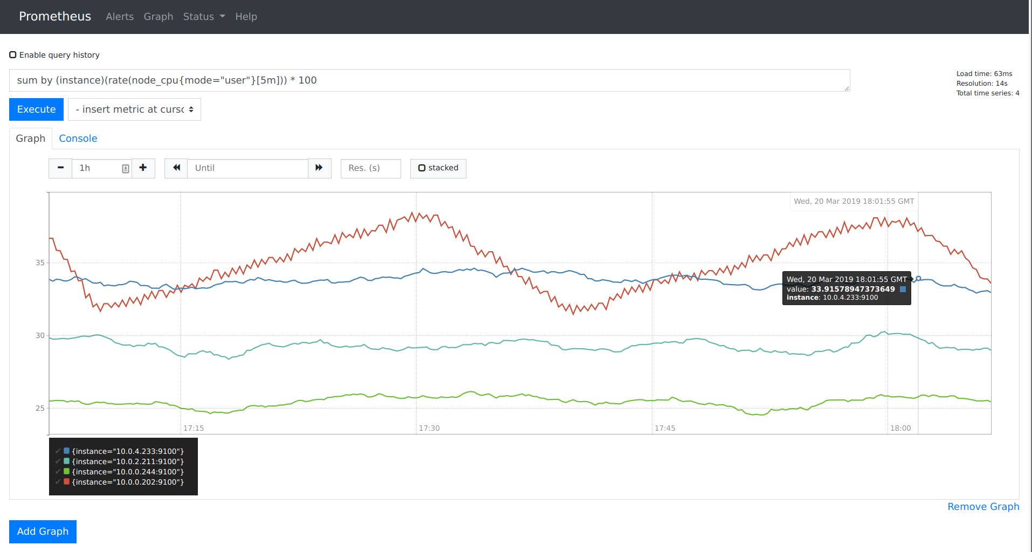
What is Prometheus?
Notes:
Collecting Aggregated data. Isn’t an event-base monitoring system, like StatsD. Prometheus is meant to collect the current state of a given set of metrics.
Prometheus teams focus on what's most important: providing a highly performant and reliable way to for collecting metrics.
No fancy interface -> Grafana
No HTTPS for web interface -> Use nginx, caddy, HAProxy
No auth -> Use LDAP, Oauth and proxy
Can create alerts with connected with alertmanager. Alert rules are defined in Prometheus, while alertmanager sends alert to external systems

Slide 12
Pulling Metrics
Pulls metrics from endpoints
Targets - which instances/apps to monitor
Can alert if an instance or app is offline
Allows for auto discovery
Kubernetes, Marathon, EC2, Azure, Google Cloud, etc...
Downsides
Not viable for short lived jobs or tasks
need to utilize pushgateway to pass metrics to Prometheus
Most of the industry is used to pushing metrics
Notes:
Pull
Can tell is something is down. If the metrics system is using push, then to tell is something is down, be it an instance or application, the metrics endpoint must know of all the endpoints that should push to it. Requires configuring on both sides!
With pull, you tell Prometheus what to monitor
If the metrics endpoint changes, be it you need to increase the number of Prometheus instances to allow for high availability or a new endpoint, don’t need to reconfigure all your endpoints.
Downsides For short lived instances, like functions as a service or containers, not viable for pulling. They can be configured to push their Prometheus metrics to a push gateway which will provide their metrics to Prometheus.

Slide 13
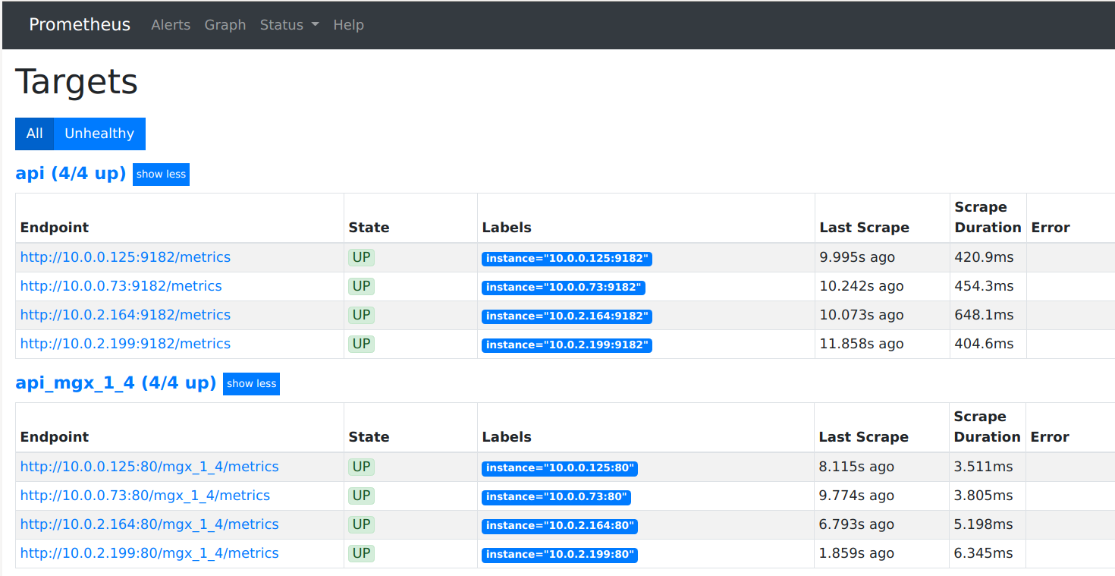
Monitoring Targets
Notes:
Collecting Aggregated data. Isn’t an event-base monitoring system, like StatsD. Prometheus is meant to collect the current state of a given set of metrics.
Prometheus teams focus on what's most important: providing a highly performant and reliable way to for collecting metrics.
No fancy interface -> Grafana
No HTTPS for web interface -> Use nginx, caddy, HAProxy
No auth -> Use LDAP, Oauth and proxy
Can create alerts with connected with alertmanager. Alert rules are defined in Prometheus, while alertmanager sends alert to external systems

Slide 14
Service Discovery
AWS EC2 Instances
Configure based on VPC, Tags
We use a combination of VPC ID’s and Tags
Uses the instances Private IP
Must have security groups setup
Kubernetes
Scrapes services that have been tagged for Prometheus
Notes:
We use a combination of VPC IDs and Tags. We have two tags configured, Prometheus and Purpose. The Prometheus purpose is used to monitor either NodeExporter, WMI Exporter, or Netdata. The purpose lets us configure how we pull the metrics. We use two values for this, Kafka and api.

Slide 15
Architecture

Slide 16
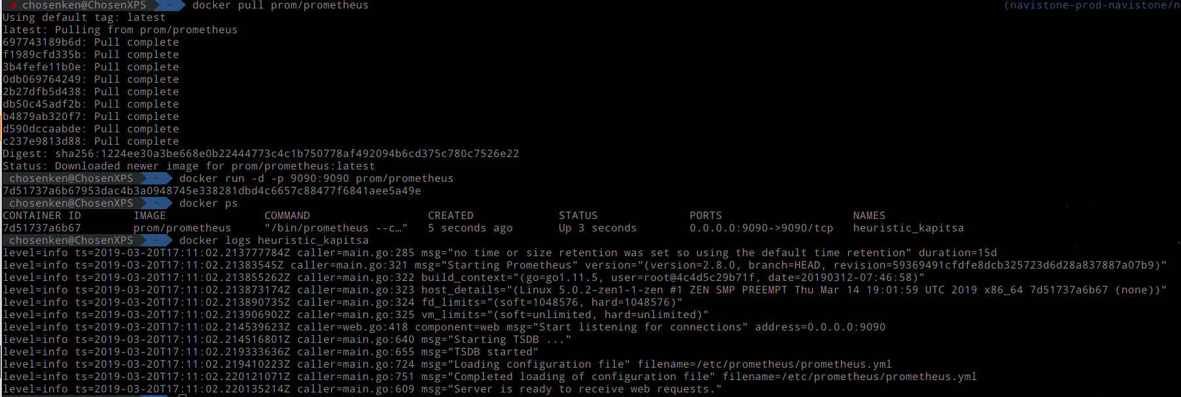
Deployment
Docker Container
Up and running in minutes
Notes:
You will want to mount in the config file and data directory. You can find more information on running the container on their docker hub page.

Slide 17
Collecting Data

Slide 18
Types of Metrics
Counter
Cumulative metric whose value can only increase or be reset to zero
Gauge
Single numerical value can go up and down
Histogram
Observes values (request duration, response size) and counts them into buckets
Summary
Calculates configurable quantiles over a sliding window of time
Notes:
Ingesting into Prometheus is easy due to the large number of community supported integrations. Node-exporter and blackbox-exporter are maintained by Prometheus, while wmi-exporter and others are community driven. Netdata is a slick, simple real time performance monitor that offers a beautiful dashboard, and uses minimal system resources. It is a great way to get a high level overview of a systems usage and resources quickly. It gathers many, many metrics, and supports exporting the metrics to Prometheus. We have node-exporter and netdata installed on all of our instances, and scrape metrics data from both.
Client libraries for dotnet, Golang, java, python, JavaScript, etc…
JMX-exporter for exporting java jmx metrics
Prometheus can read and write with various storage backends. Can persist metrics in a datastore for longer periods of time. Prometheus is not designed to store metrics for a long time, so its best to off load them to a database.

Slide 19
Labels
Key/Value Pair
Use labels to differentiate metrics
Bold is label name, Italic is label value
mgx_api_action_count{action="Action",instance="10.0.0.125:80",job="api_mgx_2",lookupKey="AADV"} 34554
mgx_api_action_count{action="Action",instance="10.0.0.125:80",job="api_mgx_2",lookupKey="ANNI"} 4532
mgx_api_action_count{action=“Action",instance="10.0.0.125:80",job="api_mgx_2",lookupKey="AUTM"} 223

Slide 20
Querying Prometheus
Functional Query Language called PromQL
Notes:
Alert rules are created in Prometheus, since they are based off data in Prometheus. Alerts are sent to Alertmanager which then handles sending the alerts to various endpoints. We use alert manager to send alerts to both Slack and Victor ops. We receive our own custom alerts as well as the alerts provided by kube-promethues.

Slide 21
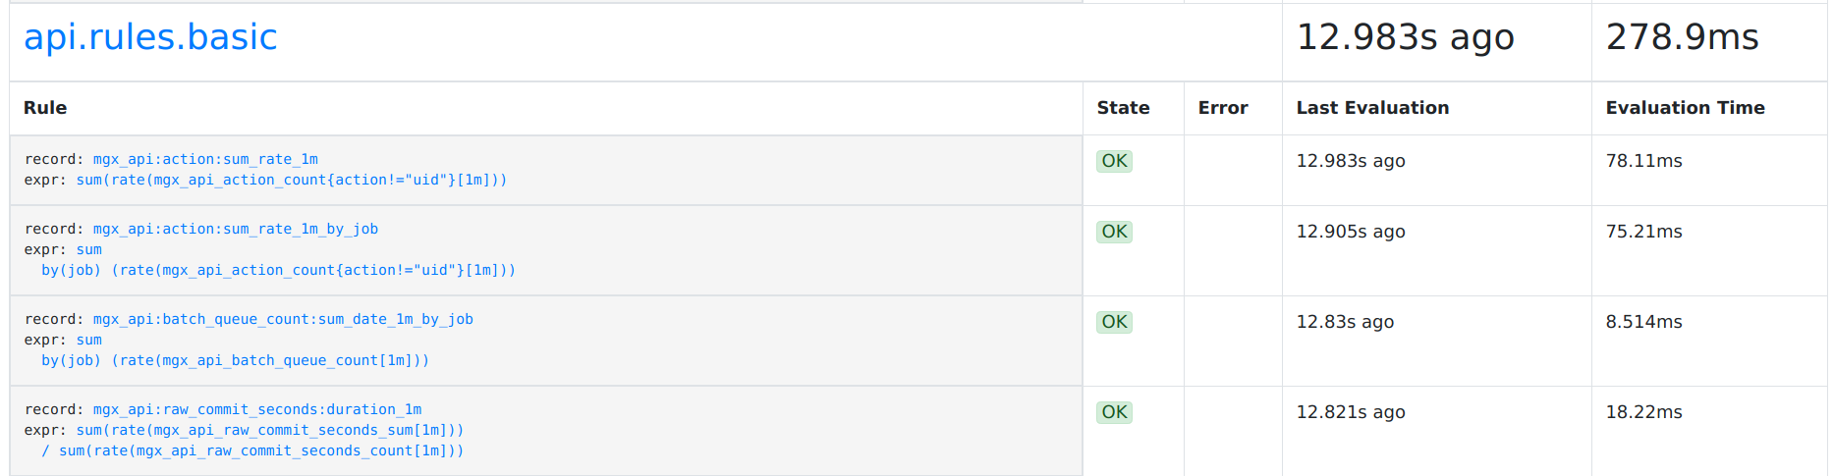
Recording Rules
Precompute frequently needed expressions and save result as a new set
Notes:
If you are scrapping every 15 seconds, that’s 4 times a minute, 240 times an hour, or 5760 time series. At 78 ms to calculate one time series, over 24 hours that will take 440 seconds (7.5 min) to calculate.
The recording rule removes the calculation time and turns into a simple search.
Down side is Prometheus currently doesn’t’ support backfill, so will only work for time series going forward.

Slide 22
Node Exporter
Exporter for Hardware and OS metrics exposed by *NIX kernels
Written in Go
Pluggable metric collectors
CPU, Memory, Filesystem, Network
Even more low level metrics like mdadm, netstat, nfs, xfs, zfs

Slide 23
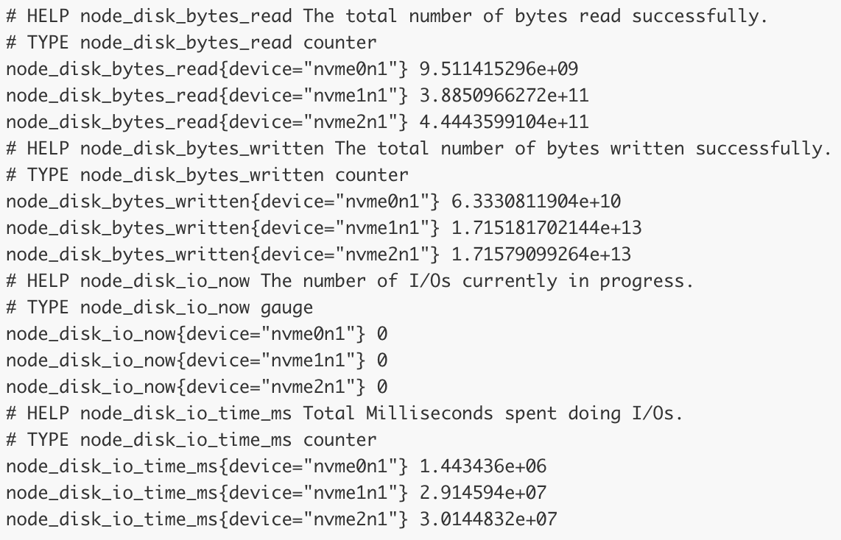
Node Exporter

Slide 24
Netdata
Realtime performance monitoring
Exports to Prometheus with a /metrics endpoint
Lightweight, used for individual system diagnosis
CPU, Memory, Disk, Network

Slide 25
Instrumentation of Applications
Client libraries in multiple languages
Creates HTTP endpoint to expose tracked metrics - /metrics
Requires development work to identify which metrics should be tracked and where in the code base the metric collection should be implemented
Notes:
Client libraries for dotnet, Golang, java, python, JavaScript, etc…
Not as simple as New Relic

Slide 26
Instantiation of Metrics

Slide 27
Push Gateway
Allows batch jobs and short lived services to expose metrics
Acts as a metrics cache
Lambda Functions
Cronjobs
Written in Go
Notes:
Acts as a metrics cache. Is not an aggregator or distributed counter. What ever metric is pushed to it will be exposed to Prometheus.

Slide 28
Windows (wmi)
WMI Exporter
Exports metrics from WMI (Windows Management Instrumentation)
CPU, Memory, Logical Disk, Network
Windows specific metrics
.NET Framework metrics
Notes:
We use the WMI Exporter to export metrics to Prometheus on our windows instances. It runs as a Windows service, providing machine level metrics. Standard metrics like CPU, Memory, Disk, Network, as well as Windows specific metrics like MSSQL, .NET Framework, and Per-Process metrics

Slide 29
Kafka
JMX Exporter
Exports Java JMX Metrics
Kafka Exporter
Exports Kafka Metrics
Partitions per topic, current offset, oldest offset, replicas
Written in Go

Slide 30
Prometheus in Production

Slide 31
Stewardship
Kubernetes and Prometheus are part of the CNCF
Reduced risk of product adoption
Conferences, training and support for project maintainers
Both development teams are working together to replace current Kubernetes metrics system (heapster) with kube-state-metrics
https://www.cncf.io/projects/
CoreDNS, OpenTracing, etcd, NATS

Slide 32
Integrations
Ingestion
node-exporter, netdata, wmi-exporter (for Windows), backbox-exporter, push-gateway
Client Libraries
JMX-exporter (Java, Kafka, Cassandra)
Remote Endpoints and Storage
Remote Write and Remote Read
InfluxDB, Postgres/TimescaleDB, Splunk, etc...
Notes:
Ingesting into Prometheus is easy due to the large number of community supported integrations. Node-exporter and blackbox-exporter are maintained by Prometheus, while wmi-exporter and others are community driven. Netdata is a slick, simple real time performance monitor that offers a beautiful dashboard, and uses minimal system resources. It is a great way to get a high level overview of a systems usage and resources quickly. It gathers many, many metrics, and supports exporting the metrics to Prometheus. We have node-exporter and netdata installed on all of our instances, and scrape metrics data from both.
Client libraries for dotnet, Golang, java, python, JavaScript, etc…
JMX-exporter for exporting java jmx metrics
The blackbox exporter allows blackbox probing of endpoints over HTTP, HTTPS, DNS, TCP and ICMP
Prometheus can read and write with various storage backends. Can persist metrics in a datastore for longer periods of time. Prometheus is not designed to store metrics for a long time, so its best to off load them to a database.

Slide 33
Alerting
Prometheus Alertmanager
Alerts are created by Prometheus, handled by Alertmanager
Built in support for clients
Email, PagerDuty, Slack, VictorOps
Supports custom Webhooks
Notes:
Alert rules are created in Prometheus, since they are based off data in Prometheus. Alerts are sent to Alertmanager which then handles sending the alerts to various endpoints. We use alert manager to send alerts to both Slack and Victor ops. We receive our own custom alerts as well as the alerts provided by kube-promethues.

Slide 34
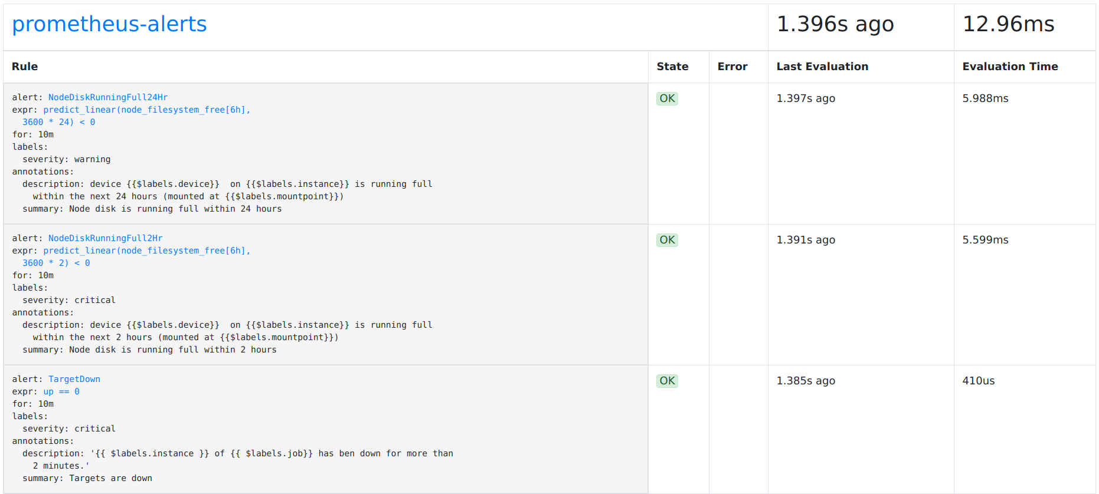
Alerting Rules
Define alert conditions based on PromQL Expression

Slide 35
Dashboard
Grafana
Beautiful Dashboards
Display data from Prometheus, InfluxDB, Elasticsearch
Used to continually monitor our Ingestion API
Notes:
Alert rules are created in Prometheus, since they are based off data in Prometheus. Alerts are sent to Alertmanager which then handles sending the alerts to various endpoints. We use alert manager to send alerts to both Slack and Victor ops. We receive our own custom alerts as well as the alerts provided by kube-promethues.

Slide 36
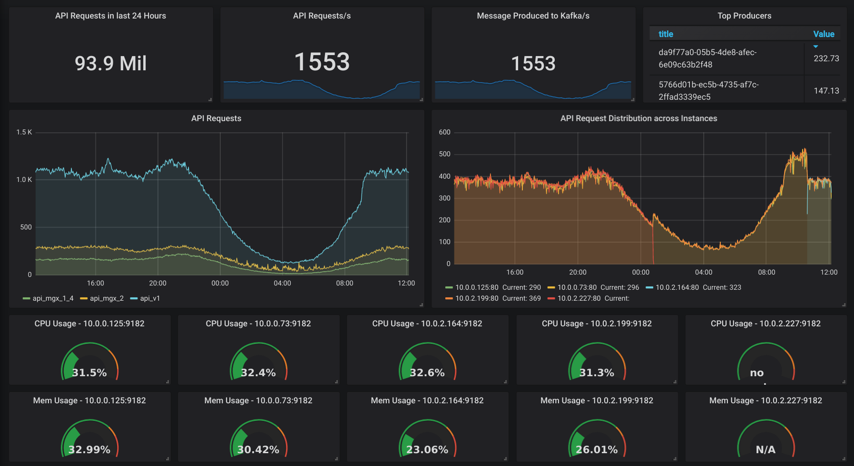
Dashboard
Notes:
Alert rules are created in Prometheus, since they are based off data in Prometheus. Alerts are sent to Alertmanager which then handles sending the alerts to various endpoints. We use alert manager to send alerts to both Slack and Victor ops. We receive our own custom alerts as well as the alerts provided by kube-promethues.

Slide 37
High Availability Strategies
Shard by environment
Production, Staging, Development
Shard by workload
Database, Backend, API
Duplication
Multiple Prometheus servers monitor the same service
Change frequency of pull, data retention period
Federation
Thanos – 3rd party
https://github.com/improbable-eng/thanos
Notes:
Alert rules are created in Prometheus, since they are based off data in Prometheus. Alerts are sent to Alertmanager which then handles sending the alerts to various endpoints. We use alert manager to send alerts to both Slack and Victor ops. We receive our own custom alerts as well as the alerts provided by kube-promethues.

Slide 38
Federation
Allows Prometheus to scrape time series from another Prometheus server
Hierarchical Federation
Useful for scaling environments with multiple datacenters.
Federation resembles a tree with higher level Prometheus servers collecting aggregated data from subordinated servers
Cross-service Federation
One server may scrape instance level metrics, while another one scrapes service metrics
Root server can scrape the instance and service servers, aggregating data into one location
Setup alerting in one location
Notes:
The way we use federation is we have one root instances on an AWS I5 instance. Chose I5 for the fast NVME SSD. It scrapes AWS instances using node-exporter and netdata. It also scrapes our Kubernetes Prometheus. The k8s Prometheus scrapes our applications and services in the kubernetes cluster. We then only have to setup alert rules and alert manager at the root level. Also allows us to retain metrics for longer. The kube Prometheus stores data for 7 days while the root stores 90 days

Slide 39
Prometheus + Kubernetes = ♥

Slide 40
Kubernetes Operator
Provides easy monitoring definitions for Kubernetes services and deployments
Create and Destroy Prometheus servers
Simple configuration
Target Kubernetes Services via Labels
Uses Kubernetes CustomResourceDefinitions
Notes:
Makes it easy to create and manage Prometheus servers in Kubernetes. Prometheus Operator takes care of the provisioning and management of the Prometheus server. Turns it into a service!

Slide 41
Monitoring Kubernetes
Kube-prometheus
Kubernetes package with all the components needed to monitor a kubernetes cluster!
Prometheus Operator
Fully managed Prometheus!
Highly Available Prometheus and Alertmanager
Prometheus node-exporter
Node exporter on every instance!
Kube-state-metrics
Get all the kubernetes metrics!
Grafana
Pretty Graphs!
Notes:
Kube-Prometheus is a collection of Kubernetes manifest files that will deploy a full Prometheus stack. It includes the Prometheus Operator, Alertmanager, Node-exporter, Kube-state-metrics, and Grafana. Kube-state-metrics is a new metrics service for kubernetes inspired by Heapster. It serves cluster level metrics and is powered by the kubernetes api.

Slide 42
Closing comments

Slide 43
Prometheus links and community
https://github.com/prometheus
Development and issue tracking
https://prometheus.io/community/
Twitter: @PrometheusIO
https://www.cncf.io/

Slide 44

Questions?
Ken Herner
Twitter: @kenXengineering
LinkedIn: kherner
Aaron Brongersma
Twitter: @abrongersma
LinkedIn: abrongersma

